Slide 1



Bank Churn Dashboard
View in Power BI
Last data refresh:
31/05/2023 07:09:19 UTC
Downloaded at:
31/05/2023 11:53:12 UTC

Slide 2
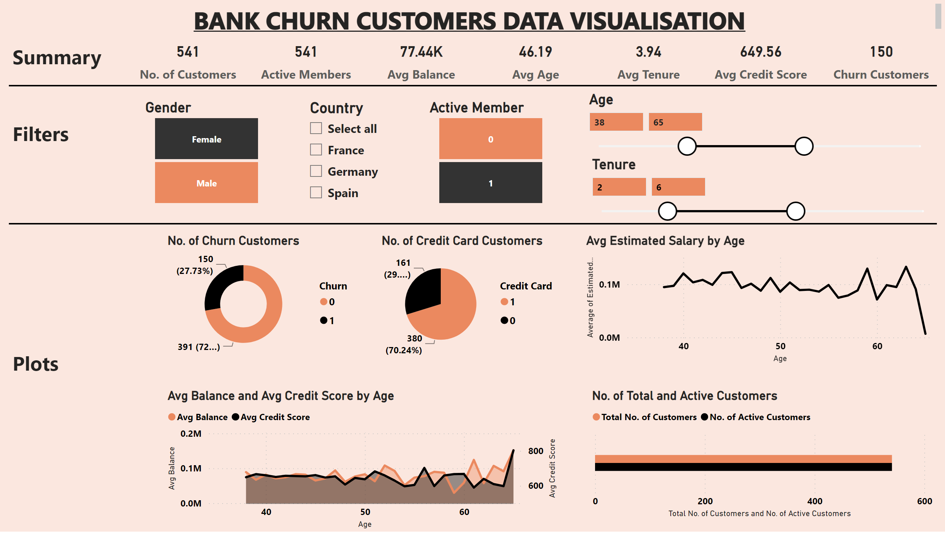
Page 1
Notes:
textbox
No alt text provided
shape
No alt text provided
card
No alt text provided
card
No alt text provided
card
No alt text provided
card
No alt text provided
card
No alt text provided
card
No alt text provided
card
No alt text provided
No. of Total and Active Customers
No alt text provided
slicer
No alt text provided
slicer
No alt text provided
slicer
No alt text provided
slicer
No alt text provided
slicer
No alt text provided
No. of Churn Customers
No alt text provided
No. of Credit Card Customers
No alt text provided
areaChart
No alt text provided
Avg Estimated Salary by Age
No alt text provided
textbox
No alt text provided
shape
No alt text provided
textbox
No alt text provided
textbox
No alt text provided

